Slide 1
Carbon Footprint Calculator
Rishikesh Vishwakarma 19
Dhanashree Wadaye 20
Shantanu Wanivadekar 21
Department of Electronics and Telecommunication
St. Francis Institute of Technology

Slide 2
Content
Introduction for Carbon Footprint Calculator
Problem Statement
Algorithm for the calculator
Concepts used
Screenshot of Output
Problems faced during execution
Each member’s contribution

Slide 3
Introduction
In a Carbon Footprint Calculator we calculate various factors contributing to global warming in the terms of their CO2 equivalent measured in Tons.
So, to calculate an individual’s carbon footprint we need to investigate various factors in his/her life to find out what ultimately contributes to the global warming.
We decided to gather these factors and make an easy to use program that would do the work for you and directly give you your Total Carbon Footprint.

Slide 4
Problem Statement
Write a program to calculate Carbon Footprint for an individual and display it.

Slide 5
Algorithm
Start.
Make a Header file of .h extension and write the formulas for all the factors i.e. LPG, Electricity, Trash, Private Vehicle, Bus, Train, Plane, Hotel all in separate functions and return the corresponding value.
In the main program #include the Header file you made.
Make classes for Household factors and Personal factors, make getters and setters for each factor.
Also make functions which return the value of CO2 Emissions in their corresponding classes.
Make a class called Total and add the total Household and Personal Emissions in it.

Slide 6
Algorithm
In main function create objects of all three classes Household, Personal and Total.
Take input for all the factors and Name and family members using setters.
In the household class divide the total emissions by number of family members to account for individual emissions.
Display all the individual emissions from each factor.
Display the Total CO2 footprint in Tons of CO2.
End.

Slide 7
Concepts Used
User-defined Header files
Classes
Functions
OOPs concept

Slide 8
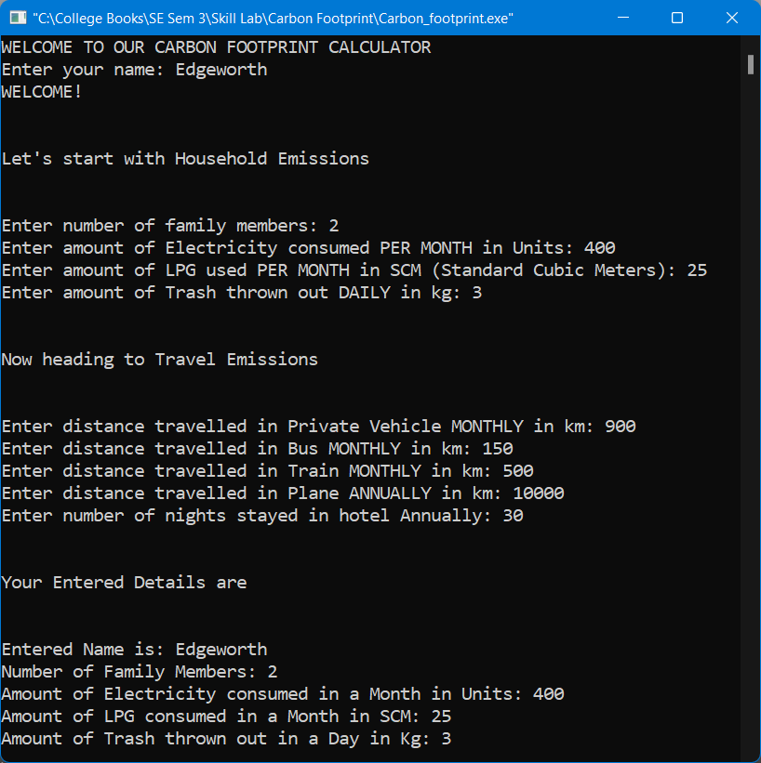
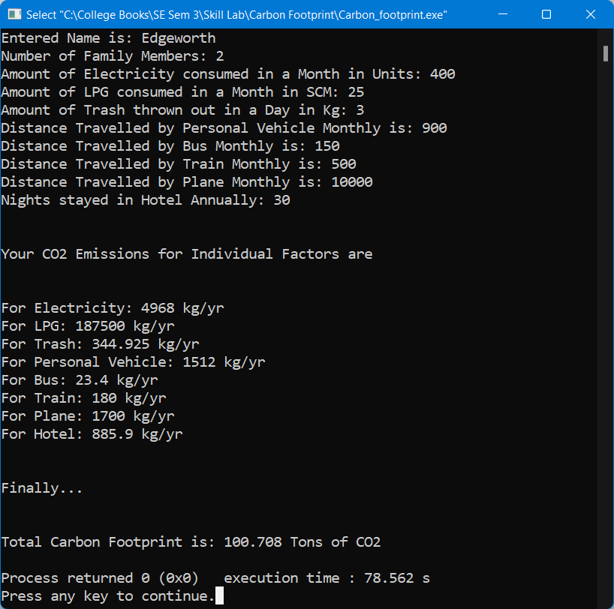
Screenshot of Output

Slide 9
Problems Faced During Execution
Returning double from an int function in header.
Accessing Private members of classes.
Not getting correct value because variable was not typecasted.
Using variable name same as function names in the user-defined header and getting error.

Slide 10
Each Member’s Contribution
Dhanashree Wadaye – Gathering Data and Making of Header file.
Shantanu Wanivadekar – Writing Code for logic and all classes.
Rishikesh Vishwakarma – Writing code for int main().

